Slide 1
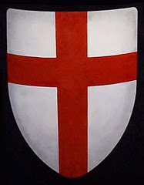
The Crusades - A lesson in religious intolerance
Christian Versus Muslim
Europe Versus Middle East
A war for the Holy Land

Slide 2
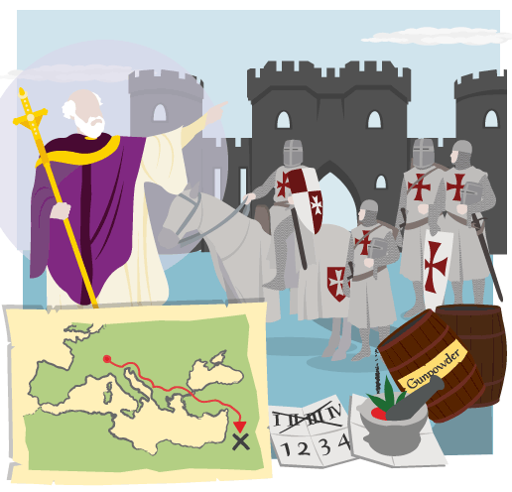
In the Middle Ages, kings and knights from Christian countries mounted military expeditions called Crusades to try to conquer the Holy Land and Jerusalem in particular.

Slide 3
Islam
The Muslim religion was founded by the Prophet Muhammad (peace be upon him) in Arabia in the 600s. Its followers believed in the new religion, Islam, and the Muslim empire grew rapidly. By 732 Muslims had conquered most of the Middle East, North Africa and Spain.

Slide 4
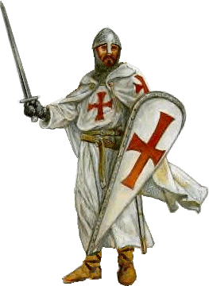
From 1087 onwards, Turks stopped Christian pilgrims from entering Jerusalem.
In 1095, Pope Urban II promised the knights of Europe forgiveness of their sins if they went on a Crusade to win back Jerusalem for Christianity.
An army of knights and nobles captured Jerusalem in 1099.

Slide 5
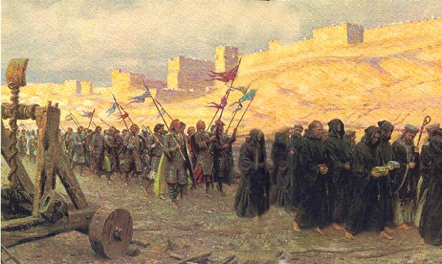
Crusaders Siege Jerusalem

Slide 6
Over the next three centuries there were many more Crusades. The Crusaders failed to keep any of the territory they conquered, but they discovered many new things, including better castle design, gunpowder, science, medicine and numbers that were easier to use than Roman numerals.
Many Crusaders committed what we would regard today as criminal atrocities.

Slide 7
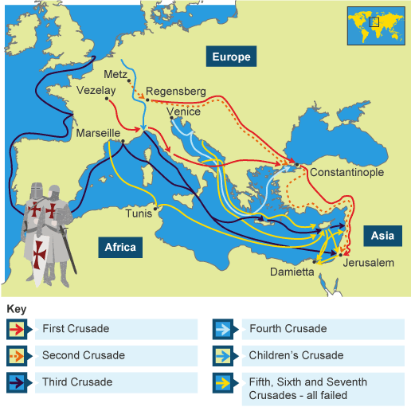

Slide 8
Significant or Not?
It would be too simplistic to see the Crusades as an attack by powerful westerners on the Muslims of the Middle East. In fact, one historian has described the Crusades as "barely a pinprick" on the Muslim world.
Others have disagreed with this few for example children in many parts of the Middle East are brought up hearing stories of the Crusades.

Slide 9
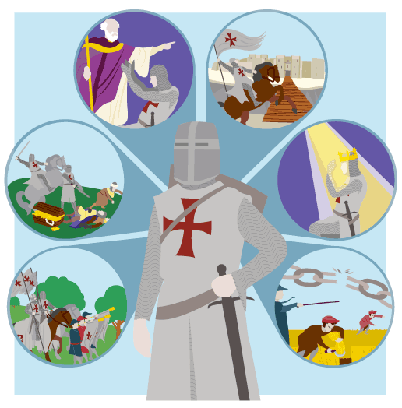
Reasons for going on Crusade
To obey the Pope's call.
To be forgiven for past sins. This was important for knights who had killed many people in battle.
To steal and kill. Kings encouraged violent knights to go on Crusade because it got them out of the country.
To see the world, have an adventure and prove their bravery.
To get land overseas. This was tempting for a younger son who would not inherit his father's lands.
Serfs joined the Crusades because the Pope promised them their freedom if they went.

Slide 10
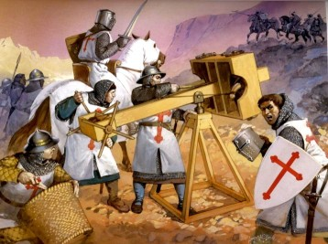

Slide 11
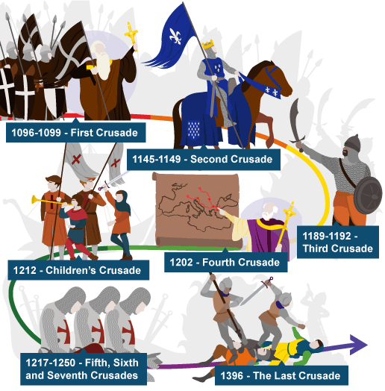

Slide 12
Activities need active listening!
Watch:
http://www.bbc.co.uk/bitesize/ks3/history/middle_ages/the_crusades/video/
Engage:
http://www.bbc.co.uk/bitesize/ks3/history/middle_ages/the_crusades/activity/
Test:
http://www.bbc.co.uk/bitesize/ks3/history/middle_ages/the_crusades/quiz/q30139645/

Slide 13
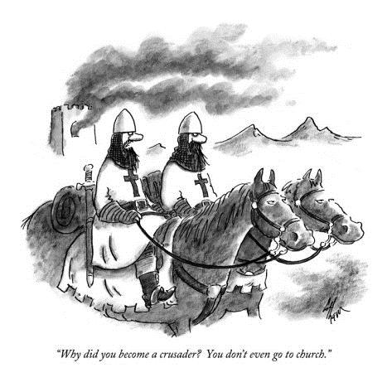
Homework
Better be prepared for next lesson…
Complete Crusader Worksheets includes reading and questions.

